Slide 1
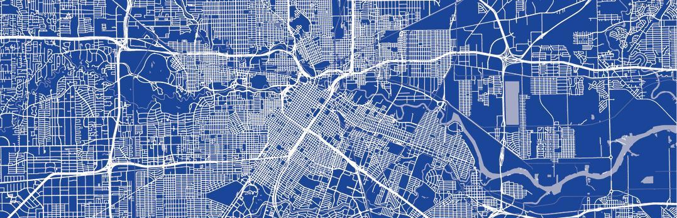
Bicycle Advisory Committee
Infrastructure Subcommittee
February 26, 2025

Slide 2
Mission and Vision
BAC Mission
To advise and make recommendations to the commission and the director on issues related to bicycling in the city including, but not limited to, amendments to the Bike Plan, bicycle safety and education, implementation of the Bike Plan, development of strategies for funding projects related to bicycling, and promoting public participation in bicycling.
BAC Vision
By 2027, the City of Houston will be a Safer, More Accessible, Gold Level Bike-Friendly City

Slide 3
Infrastructure Subcommittee Roll Call
Joe Cutrufo, Infra SC Chair
Tom Compson, BAC Chair
Alejandro Perez, BAC Vice Chair
Leah Chambers
Lisa Graiff
Trevor Reichman
Yuhayna Mahmud
Ben Drews
Amar Mohite
Mike VanDusen
Robin Holzer
Ex-officio Members
Nicole Broussard
Ian Hlavacek

Slide 4
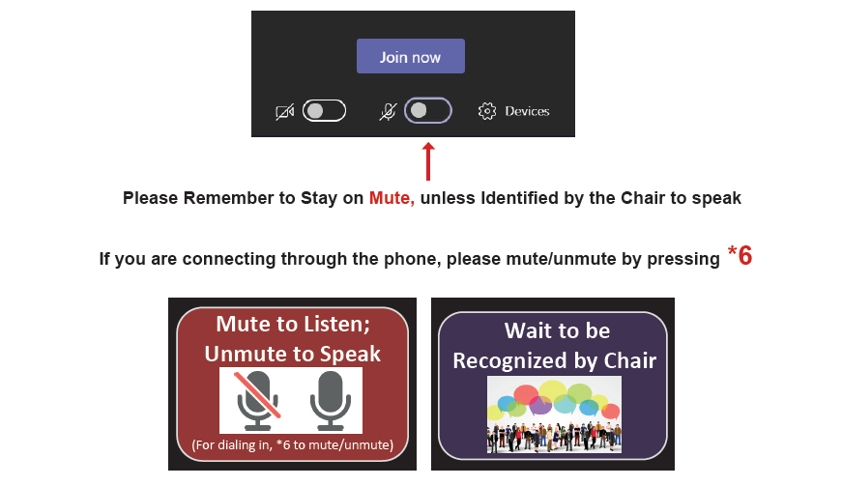
Microsoft Teams Meeting Instructions

Slide 5
Agenda
Director’s Report
Chair’s Report
Public Comment
Bryan Dotson – Recommendation for Antoine
Possible IDM Changes –Trail Crossings/Major Crosswalks
Open Forum
Announcements/Events
The public is invited to speak for up to two (2) minutes each at the beginning of the meeting.

Slide 6
Director’s Report Nicole Broussard Deputy Assistant Director, Planning & Development

Slide 7
Chair’s Report Joe Cutrufo Chair, Infrastructure Subcommittee BikeHouston

Slide 8
Public Comment
Send written comments to bac@houstontx.gov by 5:00pm the day before a BAC meeting. Comments will be read aloud by staff during the meeting.
Comment by Phone: to join dial 936-755-1521; ID 675 511 783# Press *6 to unmute when called upon by the Chair
Comment via Microsoft Teams: Type your name and that you would like to comment

Slide 9
Bryan Dotson – Recommendation for Antoine

Slide 10
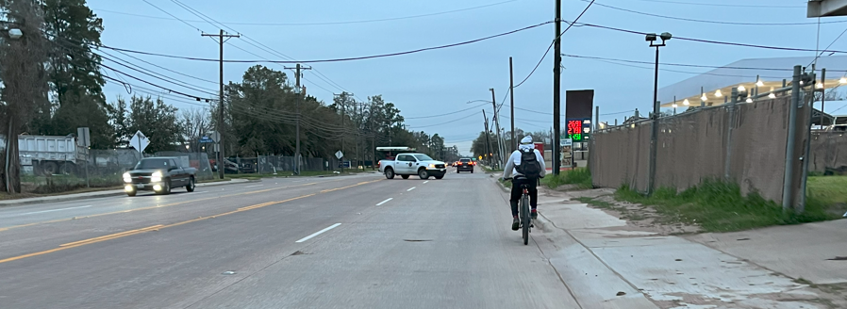
Antoine Sidepath
Invisible Bicycle Rider on Brittmoore.. Typical of area
Bryan Dotson for February 26, 2025
BAC Infrastructure Subcommittee

Slide 11
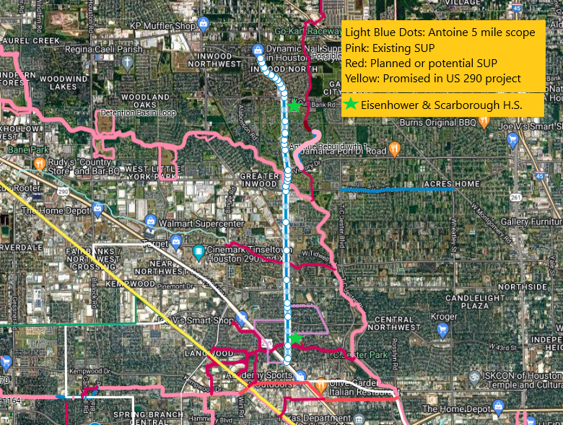
Recommendation for Antoine
10’ sidepath, nominally on east side, retaining 6’ sidewalk on opposite side.
Successful model for residential section is S. Kirkwood. For commercial/apartments, Almeda.
About 12% of adjacent households (3300) do not have a motor vehicle.
Important local destinations are Eisenhower HS, Scarborough HS, Foodtown. Corridor for high-ridership Metro 85.
On Bike Plan: Regional connections now to White Oak Bayou Greenway, planned Vogel Creek Greenway, Spring Branch Trail, and potential alignments on Cole Creek and Brickhouse Gully.

Slide 12
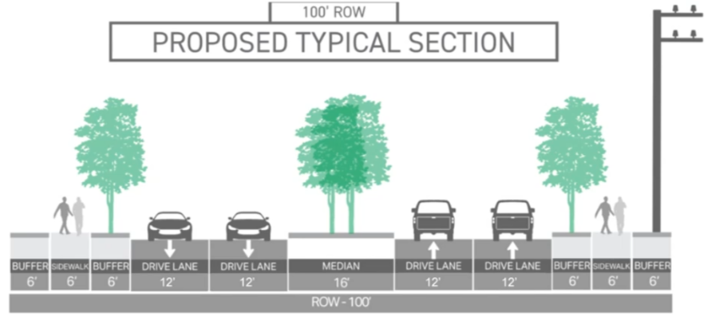
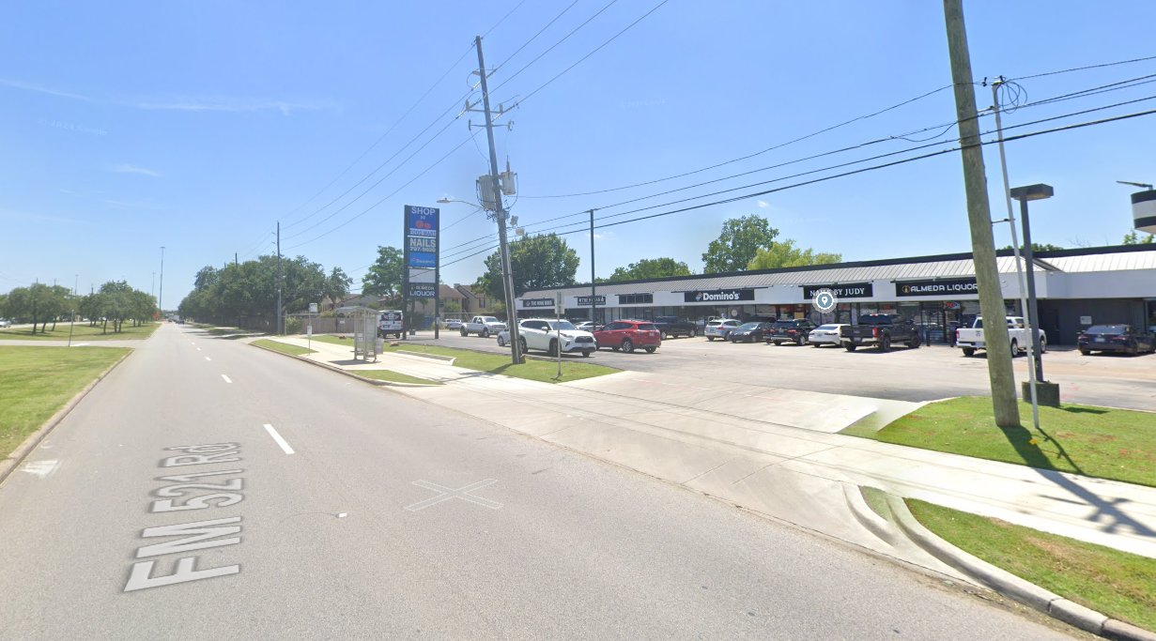
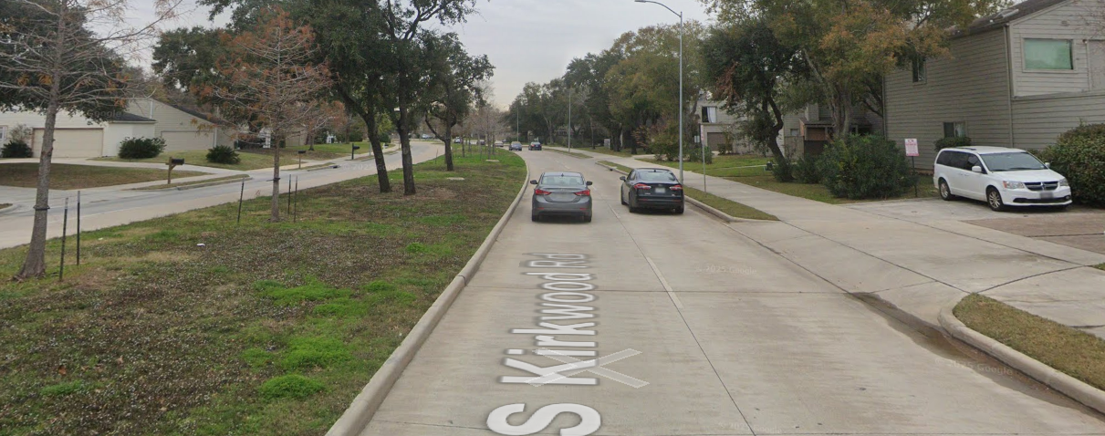
Successful Examples
Residential single-family: S. Kirkwood from Buffalo Bayou to Briar Forest.
Commercial/apartments: Almeda from Old Spanish Trail to Holly Hall.
ROW permits 10’ sidepath
Almeda Looking South Kirkwood Looking North

Slide 13
Possible IDM Changes – Trail Crossings/Major Crosswalks

Slide 14
Agenda
Director’s Report
Chair’s Report
Public Comment
Bryan Dotson – Recommendation for Antoine
Possible IDM Changes – Trail Crossings/Major Crosswalks
Open Forum
Announcements/Events
The public is invited to speak for up to two (2) minutes each at the beginning of the meeting.

Slide 15
Open Forum

Slide 16
Announcements and Events

Slide 17
Announcements
Next Meetings
Bicycle Advisory Committee Meeting (rescheduled from Jan): March 19
Education Subcommittee: March 26
Bicycle Advisory Committee: April 23
Infrastructure Subcommittee: May 28

Slide 18
Thank You
832-393-6600 | www.houston.tx.gov/planning

